Slide 1


Modern Operating Systems
Fifth Edition
Chapter 2
Scheduling
Copyright © 2023, 2014, 2008 Pearson Education, Inc. All Rights Reserved
Notes:
If this PowerPoint presentation contains mathematical equations, you may need to check that your computer has the following installed:
1) MathType Plugin
2) Math Player (free versions available)
3) NVDA Reader (free versions available)

Slide 2
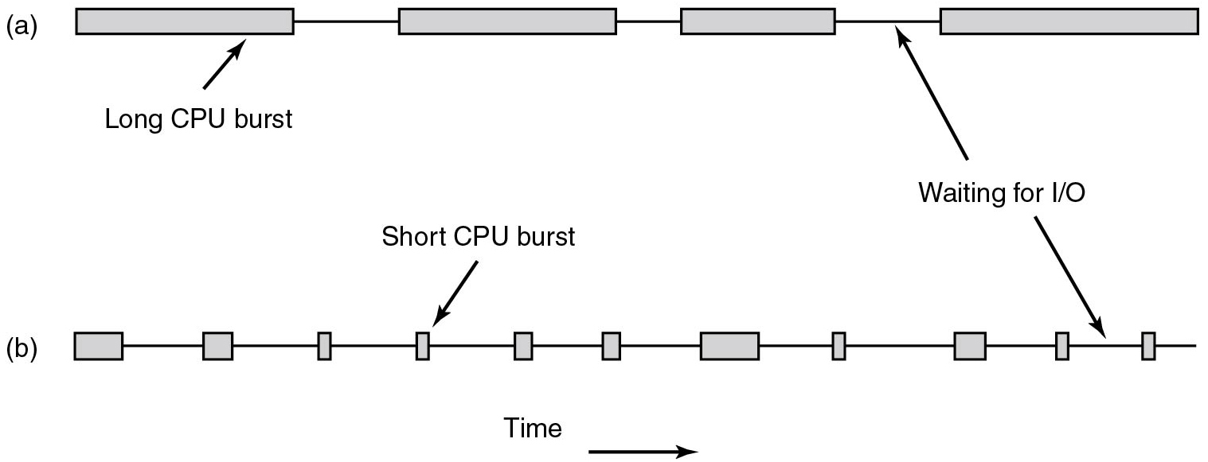
Introduction to Scheduling Process Behavior
C P U bound versus. I/O bound processes
Figure 2.40 Bursts of C P U usage alternate with periods of waiting for I/O. (a) A C P U-bound process. (b) An I/O-bound process.
Notes:
Long description:
Part (a): There are four horizontal rectangular blocks connected with each other where the first and last are not connected. The first block is labeled Long C P U burst. The third block is the smallest. Part (b): There are eleven rectangular blocks of different sizes. The Time is denoted by a forward arrow at the bottom. The fourth block with an arrow on top is labeled Short C P U burst. There is a bidirectional arrow between the tenth and eleventh blocks labeled Waiting for I/O points between a third and fourth block of part (a).

Slide 3
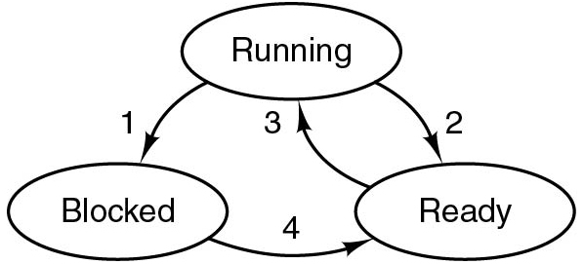
Process State Revisited
If more processes ready than C P U s available:
Scheduler decides which process to run next
Algorithm used by scheduler is called scheduling algorithm
Notes:
Long Description:
The arrows are labeled as follows. 1, from running to blocked. 2, from running to ready. 3, from ready to running. 4, from blocked to ready.

Slide 4
When to Schedule?
Process exits
Process blocks on I/O, Semaphore, etc.
When a new process is created
When an interrupt occurs:
I/O, clock, syscall, etc.
Preemptive versus non-preemptive scheduling?

Slide 5
Categories of Scheduling Algorithms
Batch
Interactive
Real time

Slide 6
Scheduling Algorithm Goals
Different goals for different systems
Batch
Interactive
Real time
All systems:
Fairness - giving each process a fair share of the C P U
Policy enforcement - seeing that stated policy is carried out
Balance - keeping all parts of the system busy

Slide 7
Scheduling Criteria
CPU utilization – keep the CPU as busy as possible
Throughput – # of processes that complete their execution per time unit
Turnaround time – amount of time to execute a particular process
Waiting time – amount of time a process has been waiting in the ready queue
Response time – amount of time it takes from when a request was submitted until the first response is produced, not output (for time-sharing environment)

Slide 8

Batch Systems
Scanrail/123 R F
Throughput : maximize jobs per hour
Turnaround time : minimize time between submission and termination
C P U utilization : keeping the C P U busy all the time
Notes:
Image from: https://c4.wallpaperflare.com/wallpaper/1001/284/24/server-room-tiles-lights-wallpaper-preview.jpg

Slide 9
First-Come First-Served
Process jobs in order of their arrival
Non-preemptive
Single Process Queue
New jobs or blocking processes are added to the end of the queue
“Convoy Effect” if only few C P U bound and many I/O bound processes

Slide 10
First- Come, First-Served (FCFS) Scheduling
Process Burst Time
P₁ 24
P₂ 3
P₃ 3
Suppose that the processes arrive in the order: P₁ , P₂ , P₃ The Gantt Chart for the schedule is:
Waiting time for P₁ = 0; P₂ = 24; P₃ = 27
Average waiting time: (0 + 24 + 27)/3 = 17

Slide 11
Shortest-Job-First (SJF) Scheduling
Associate with each process the length of its next CPU burst
Use these lengths to schedule the process with the shortest time
SJF is optimal – gives minimum average waiting time for a given set of processes
The difficulty is knowing the length of the next CPU request
Could ask the user

Slide 12
Example of SJF
ProcessArriva l Time Burst Time
P₁ 0.0 6
P₂ 2.0 8
P₃ 4.0 7
P₄ 5.0 3
SJF scheduling chart
Average waiting time = (3 + 16 + 9 + 0) / 4 = 7

Slide 13
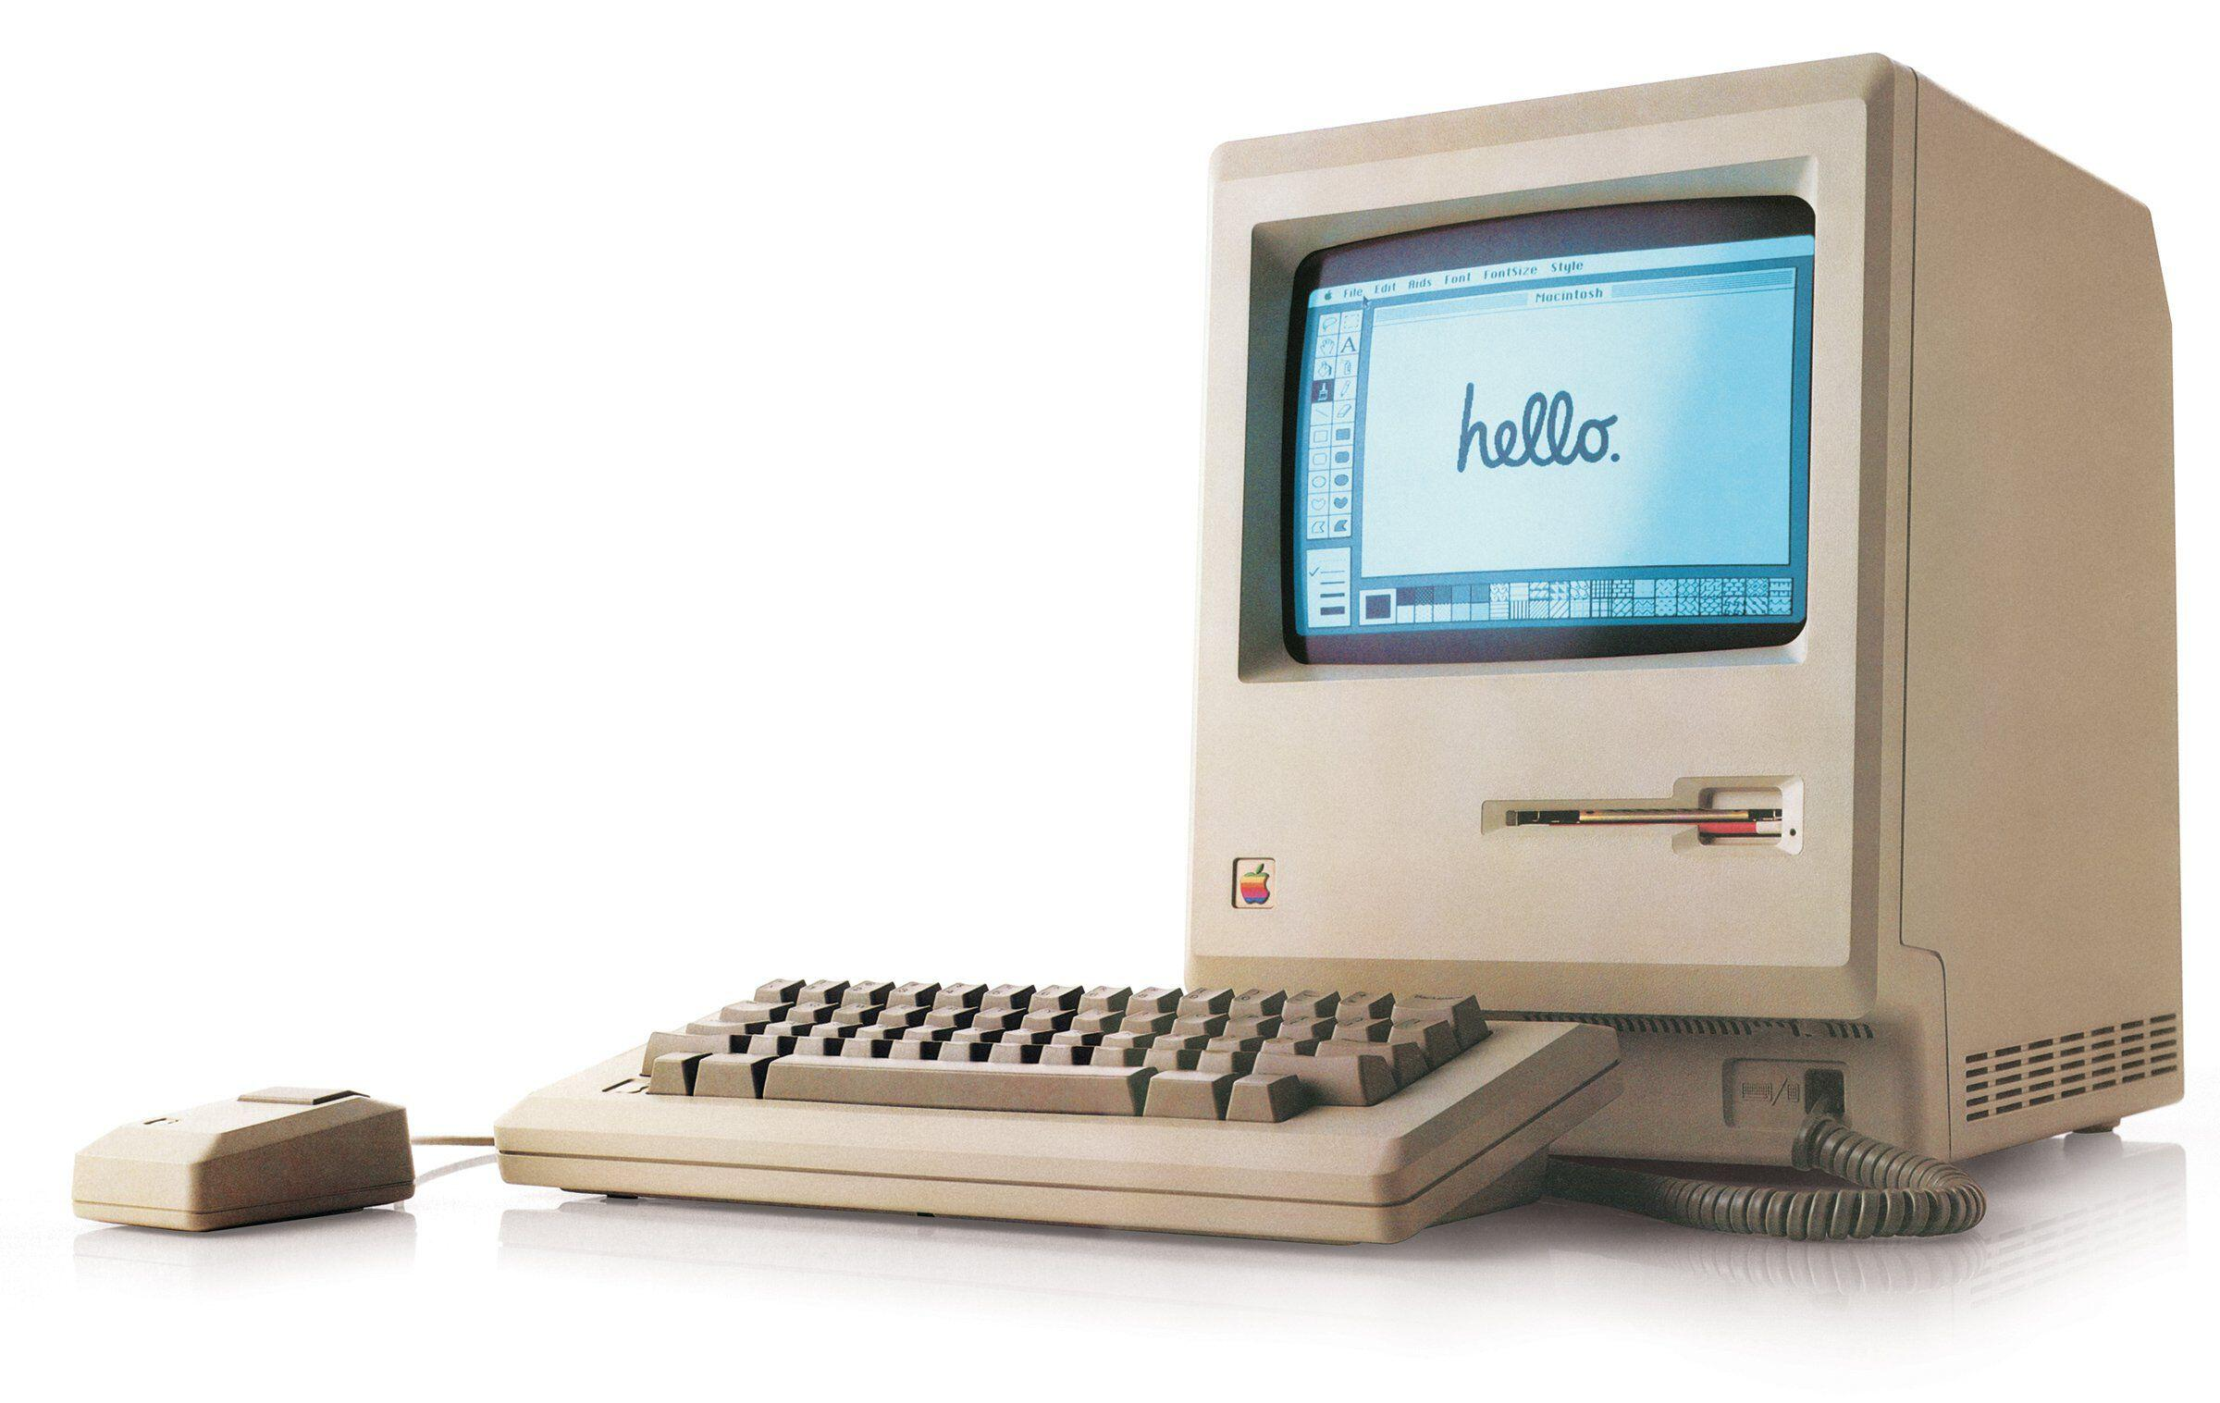
Interactive Systems
Response time: respond to requests quickly
Proportionality: meet users’ expectations
M c Clatchy-Tribune/Tribune Content Agency L L C/Alamy Stock Photo
Apple MacIntosh (1984)
Notes:
Image from: https://i1.wp.com/www.clipset.net/wp-content/uploads/2009/01/1984-apple-macintosh.jpg?resize=450%2C234

Slide 14
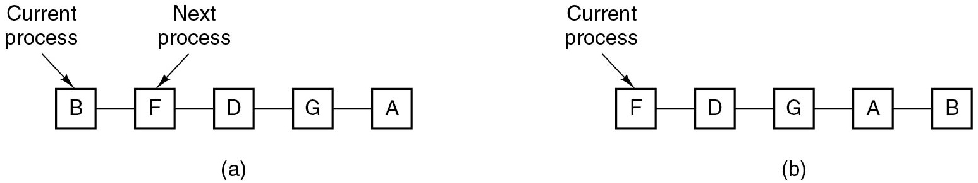
Round Robin Scheduling
Preemptive scheduling algorithm
Each process gets a time slice or quantum
If process is still running at end of quantum it gets preempted end goes to end of ready queue
Question: How big should the quantum be?
C P U utilization versus. response time
Notes:
Long Description:
Part (a): Five square blocks are connected with each other horizontally where the first and last blocks are not connected. The five blocks are labeled B, F, D, G, and A from left to right. The B block is labeled Current process and the F block is labeled Next process. Part (b): Five square blocks are connected with each other horizontally where the first and last blocks are not connected. The five blocks are labeled F, D, G, A, and B from left to right. The F block is labeled Current process.

Slide 15
Example of RR with Time Quantum = 4
Process Burst Time
P₁ 24
P₂ 3
P₃ 3
The Gantt chart is:
Typically, higher average turnaround than SJF, but better response
q should be large compared to context switch time
q usually 10ms to 100ms, context switch < 10 usec

Slide 16
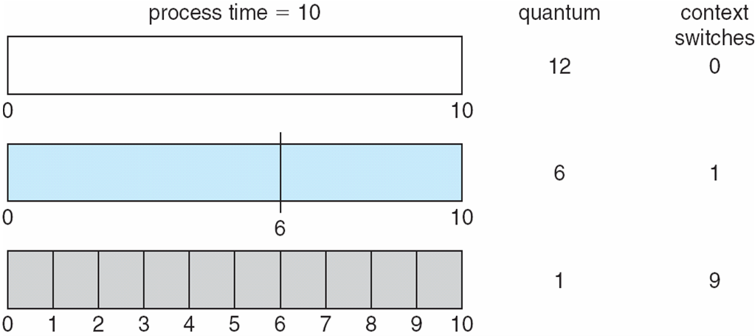
Time Quantum and Context Switch Time

Slide 17
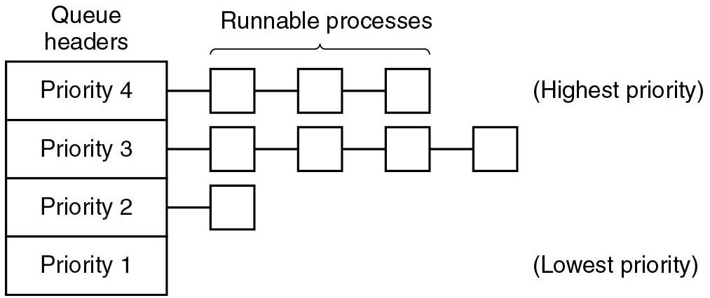
Priority Scheduling (1 of 2)
Simplest, multiple queues
Similar to round robin but several ready queues
Next process is picked from queue with highest priority
Static versus. dynamic priorities
What processes should have high priorities?
Notes:
Long Description:
A vertical rectangular block is labeled Queue Headers and has four partitions from top to bottom labeled Priority 4, Priority 3, Priority 2, and Priority 1. There are Runnable processes connected with each partition. Priority 4 has three horizontal blocks connected with Highest Priority. Priority 3 has four horizontal blocks connected. Priority 2 has one horizontal block connected. Priority 1 has no block connected and is labeled with Lowest Priority.

Slide 18
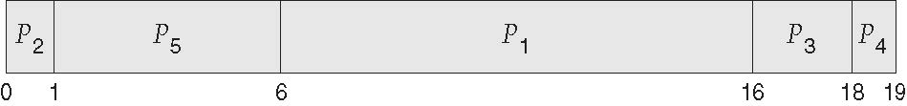
Example of Priority Scheduling
ProcessA arri Burst TimeT Priority
P₁ 10 3
P₂ 1 1
P₃ 2 4
P₄ 1 5
P₅ 5 2
Priority scheduling Gantt Chart
Average waiting time = 8.2 msec

Slide 19
Shortest Process Next
Problem: How to minimize response time for each priority queue?
Idea: Use shortest “job” first and try to best predict next running time
whatever runs between the waits
Solution: Form weighted average of previous running times of
process
Aging
Easy to implement when
Notes:
counterpart to S J F for interactive processes
a=1/2 → add new T to old estimate and shift right
Long Description:
T subscript k plus 1 equals a times T subscript k plus 1 plus open parenthesis 1 minus a close parenthesis times T subscript k.

Slide 20
Example of SJF
ProcessArriva l Time Burst Time
P₁ 0.0 6
P₂ 2.0 8
P₃ 4.0 7
P₄ 5.0 3
SJF scheduling chart
Average waiting time = (3 + 16 + 9 + 0) / 4 = 7

Slide 21
Determining Length of Next CPU Burst
Can only estimate the length – should be similar to the previous one
Then pick process with shortest predicted next CPU burst
Can be done by using the length of previous CPU bursts, using exponential averaging
Commonly, α set to ½
Preemptive version called shortest-remaining-time-first

Slide 22
Guaranteed Scheduling
Idea: N processes running
each process gets 1/Nth of C P U time
(also known as fair-share)
Solution:
Calculate how much C P U time it might have gotten:
Time since process creation divided by N
Measure actual consumed C P U time and form ratio
0.5
process running half the time it was entitled to
2.0
process running twice as much as it was entitled to
Pick process with the smallest ratio to run next
How to incorporate priorities (See Linux’ C F S)?
Note: fair-share scheduling can be per-user/-process

Slide 23
Lottery Scheduling
Processes get lottery tickets
Whenever a scheduling decision is made O S chooses a winning ticket randomly
Processes can possess multiple tickets
Priorities
Tickets can be traded between processes.
Tickets are immediately available to newly created processes.

Slide 24
Policy versus. Mechanism
Important principle
Here: we may have a scheduling algorithm, but parameters to be filled in by user (process)
For instance, to give some child processes higher priority than others

Slide 25

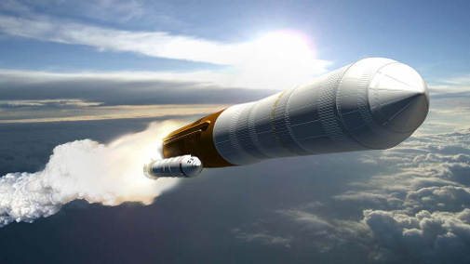
Real Time Systems (1 of 3)
Yauhen_D/Shutterstock
N A S A
Meeting deadlines: avoid losing data
Predictability: avoid quality degradation in multimedia systems
Notes:
Image 1 from: http://3.bp.blogspot.com/-NGf3lFSPR3Y/UitdAdHIoUI/AAAAAAAABZs/oHsrdYu0Zfo/s1600/braking.jpg
Image 2 from: https://www.universetoday.com/wp-content/uploads/2010/01/149769main_CaLV_launch_full.jpg

Slide 26
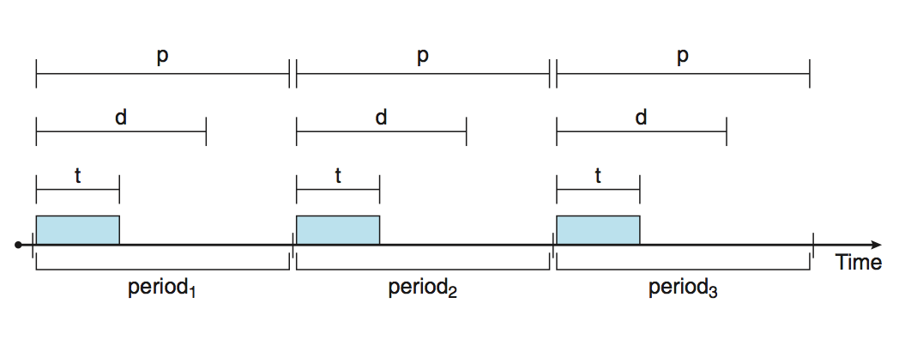
Priority-based Scheduling
For real-time scheduling, scheduler must support preemptive, priority-based scheduling
But only guarantees soft real-time
For hard real-time must also provide ability to meet deadlines
Processes have new characteristics: periodic ones require CPU at constant intervals
Has processing time t, deadline d, period p
0 ≤ t ≤ d ≤ p
Rate of periodic task is 1/p

Slide 27
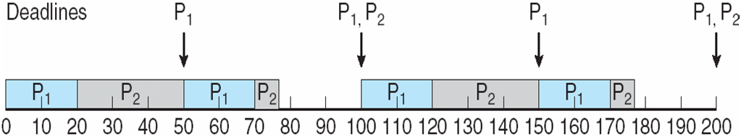
Rate Montonic Scheduling
P1 and P2 are 50 and 100, respectively—that is, p1 = 50 and p2 = 100. The
processing times are t1 = 20 for P1 and t2 = 35 for P2. The deadline for each
process requires that it complete its CPU burst by the start of its next period.

Slide 28
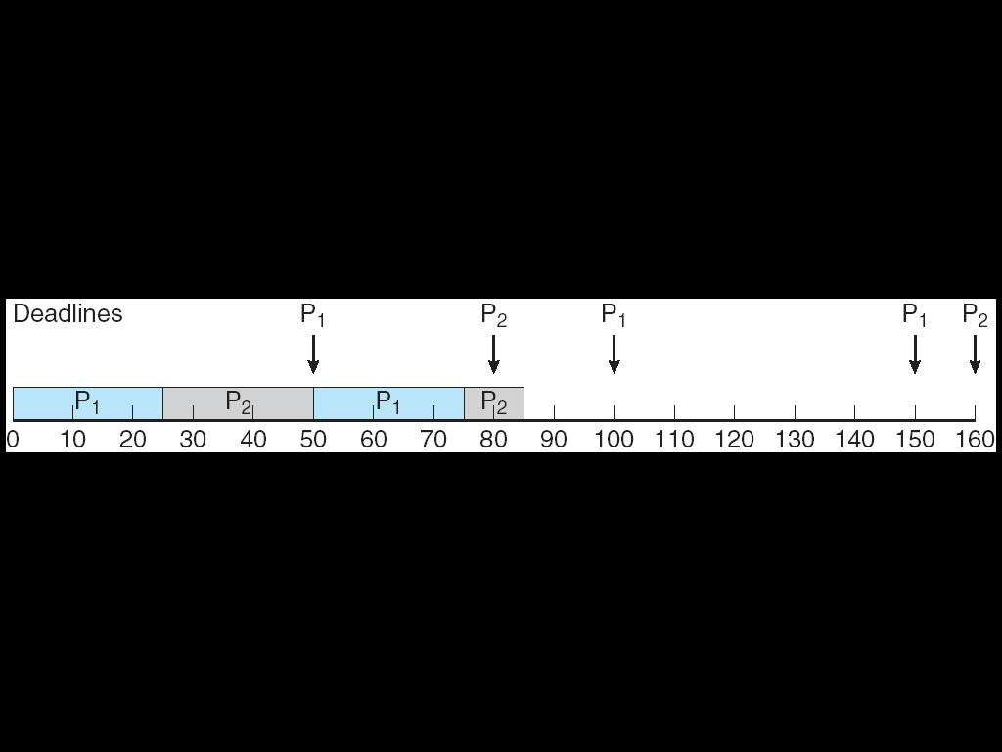
Missed Deadlines with Rate Monotonic Scheduling
Assume that process P1 has a period of p1 = 50 and a CPU burst of t1 = 25.
For P2, the corresponding values are p2 = 80 and t2 = 35.

Slide 29
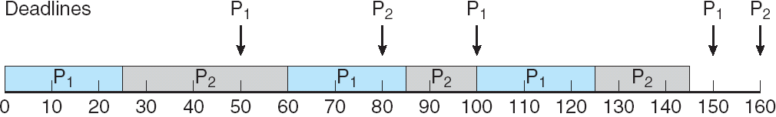
Earliest Deadline First Scheduling (EDF)
Priorities are assigned according to deadlines:
the earlier the deadline, the higher the priority;
the later the deadline, the lower the priority
Recall that P1 has values of p1 = 50 and t1 = 25 and that P2 has
values of p2 = 80 and t2 = 35.

Slide 30
Scheduling Algorithm Goals
Interactive systems
Response time - respond to requests quickly
Proportionality - meet users' expectations
Real-time systems
Meeting deadlines - avoid losing data
Predictability - avoid quality degradation in multimedia systems

Slide 31
POSIX Real-Time Scheduling
The POSIX.1b standard
API provides functions for managing real-time threads
Defines two scheduling classes for real-time threads:
SCHED_FIFO - threads are scheduled using a FCFS strategy with a FIFO queue. There is no time-slicing for threads of equal priority
SCHED_RR - similar to SCHED_FIFO except time-slicing occurs for threads of equal priority
Defines two functions for getting and setting scheduling policy:
pthread_attr_getsched_policy(pthread_attr_t *attr, int *policy)
pthread_attr_setsched_policy(pthread_attr_t *attr, int policy)

Slide 32
POSIX Real-Time Scheduling API
#include <pthread.h>
#include <stdio.h>
#define NUM_THREADS 5
int main(int argc, char *argv[])
{
int i, policy; pthread_t_tid[NUM_THREADS];
pthread_attr_t attr;
/* get the default attributes */
pthread_attr_init(&attr);
/* get the current scheduling policy */ if (pthread_attr_getschedpolicy(&attr, &policy) != 0)
fprintf(stderr, "Unable to get policy.\n");
else {
if (policy == SCHED_OTHER) printf("SCHED_OTHER\n");
else if (policy == SCHED_RR) printf("SCHED_RR\n");
else if (policy == SCHED_FIFO) printf("SCHED_FIFO\n");
}

Slide 33
POSIX Real-Time Scheduling API (Cont.)
/* set the scheduling policy - FIFO, RR, or OTHER */ if (pthread_attr_setschedpolicy(&attr, SCHED_FIFO) != 0)
fprintf(stderr, "Unable to set policy.\n");
/* create the threads */ for (i = 0; i < NUM_THREADS; i++)
pthread_create(&tid[i],&attr,runner,NULL);
/* now join on each thread */ for (i = 0; i < NUM_THREADS; i++)
pthread_join(tid[i], NULL);
}
/* Each thread will begin control in this function */
void *runner(void *param) {
/* do some work ... */
pthread_exit(0);
}

Slide 34
Multiple-Processor Scheduling
CPU scheduling more complex when multiple CPUs are available
Homogeneous processors within a multiprocessor
Asymmetric multiprocessing – only one processor accesses the system data structures, alleviating the need for data sharing
Symmetric multiprocessing (SMP) – each processor is self-scheduling, all processes in common ready queue, or each has its own private queue of ready processes
Currently, most common
Processor affinity – process has affinity for processor on which it is currently running
soft affinity
hard affinity
Variations including processor sets

Slide 35
Multiple-Processor Scheduling – Load Balancing
If SMP, need to keep all CPUs loaded for efficiency
Load balancing attempts to keep workload evenly distributed
Push migration – periodic task checks load on each processor, and if found pushes task from overloaded CPU to other CPUs
Pull migration – idle processors pulls waiting task from busy processor

Slide 36
Modern Operating Systems
Fifth Edition
Chapter 2
Scheduling - End
Copyright © 2023, 2014, 2008 Pearson Education, Inc. All Rights Reserved
Notes:
If this PowerPoint presentation contains mathematical equations, you may need to check that your computer has the following installed:
1) MathType Plugin
2) Math Player (free versions available)
3) NVDA Reader (free versions available)

